Slide 1

Implementation of GitHub into research workflow
Alessandro Sparacio
LIP/PC2S

Slide 2

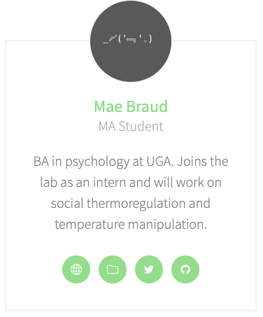
Members

Slide 3


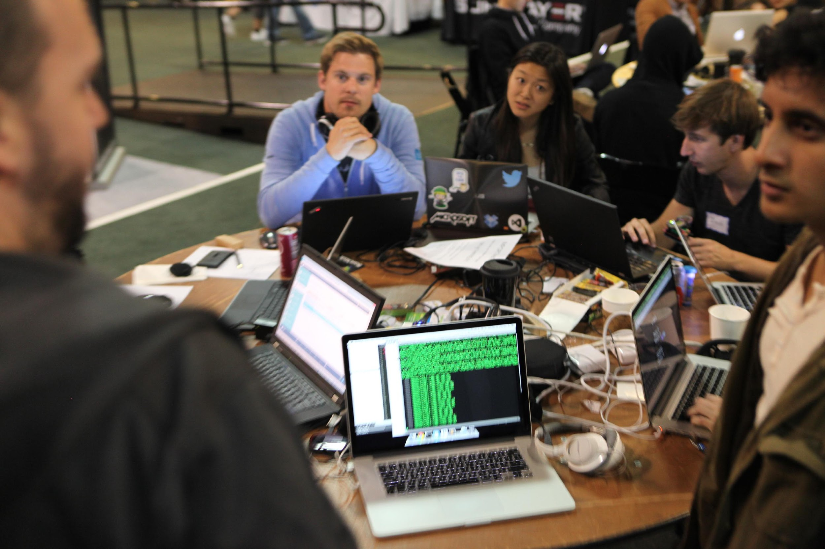




Co-regulation in romantic relationships
Social thermoregulation
Open science ideals

Slide 4


GitHub: What are we talking about?
Objective:
Knowing GitHub
Understanding how it can be implemented in your workflow
Exploring the benefits of using Github
Notes:
I will tell you that the advantages are more than the drawbacks, even if the interface is not very user friendly, there are some basic github functions that will make your job easier, more agile and faster. github allows you to saves considerable time and energy because you will be able to organize your work in a more efficient way. I will explain the basic functions of github and then I will give you a practical example of how tcan be used to speed up the realization of a project

Slide 5
GitHub: What are we talking about?
Version control system
Social networks for developers
Notes:
Version control is a system that records changes to a file or set of files over time so that you can recall specific versions later. A version control system is a category of software tools that helps record changes to files by keeping a track of the modification done to the code. It can be thought as a database of changes It contains all the edits and historical versions (snapshots) of the project.

Slide 6
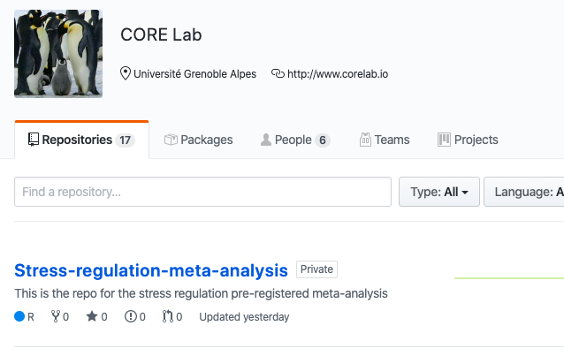
GitHub: What are we talking about?
Version control system
Notes:
Here, How it looks like. What you see in the screen is an organization account, but everyone can create a personal account. Usually they are quite the same, but the main difference is that in a company account all members of the company can contribute to one of the project, instead in the private account you have invite the collaborators that you want to include in your project.

Slide 7
GitHub: What are we talking about?
Why use GitHub?
It makes it easier to work with other people:
No email or onedrive folder to send new scripts
It will be possible to work on the same file at the same time, with more people
Git will combine the changes automatically and it will display all the ambiguites and conflicts
Notes:
There are some compelling reasons for using Github

Slide 8
GitHub: What are we talking about?
Why use GitHub?
It is easier to spot mistakes:
It is possible to see exactly small variations made to the script, preventing big wasting of time

Slide 9
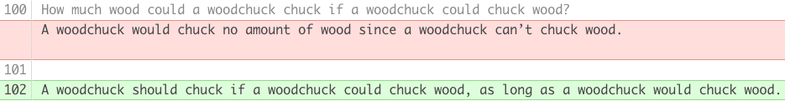
GitHub: What are we talking about?
Let’s see into detail
The background color nudges you to the changes that have been made:
Green (for text that has been added)
Red (for text that has been removed)
Notes:
Let’s say you have a script of hundred and hundred lines of code. Without GitHub it would have been really hard to spot the changes that have been done to the line of code (by you, or one of your collaborator)

Slide 10

GitHub: What are we talking about?
… But, someone might say…
I already use OSF, why should I use GitHub?

Slide 11
GitHub: What are we talking about?
… Because GitHub allow you to do the same (and more) things In a way, that is easier and faster
It is also possibile to integrate GitHub into your project in OSF

Slide 12
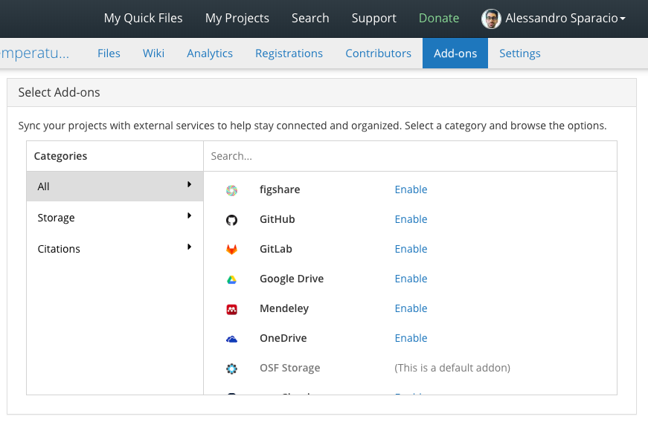
GitHub: What are we talking about?

Slide 13
GitHub: What are we talking about?
How to start?
Step 1) Install Git & create GitHub account
Git is an open-source tool developers install locally to manage source code
GitHub is an online service to which developers who use Git can connect and upload or download resources
Notes:
Git is installed locally, GitHub is hosted by the cloud. Git allows you to work with GitHub.

Slide 14
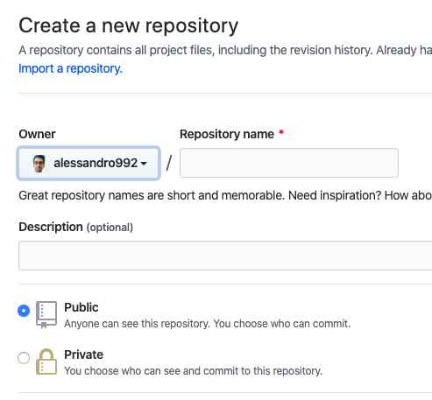
GitHub: What are we talking about?
How to start?
Step 2) Create a repository on GitHub
Notes:
Repository: Central place where scripts are stored and mantained

Slide 15
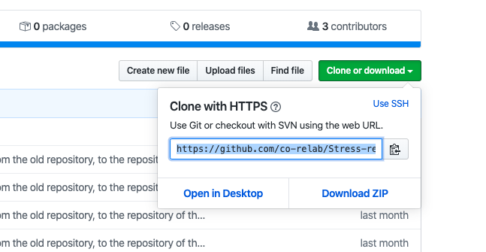
GitHub: What are we talking about?
How to start with GitHub?
Step 3) Clone a repository from GitHub
Notes:
A clone is a copy of a repository that lives on your computer instead of on a website's server somewhere, or the act of making that copy. With your clone you can edit the files in your preferred editor and use Git to keep track of your changes without having to be online. It is, however, connected to the remote version so that changes can be synced between the two

Slide 16
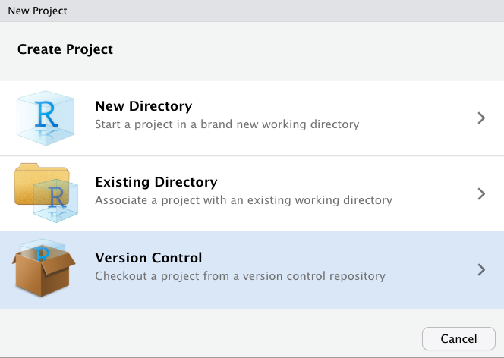
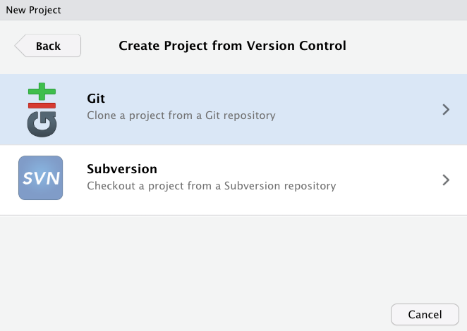
GitHub: What are we talking about?
How to start with GitHub?
Step 3) Clone a repository from GitHub

Slide 17
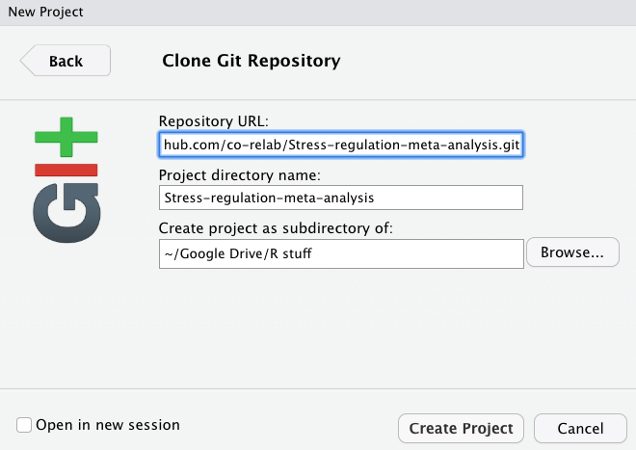
GitHub: What are we talking about?
How to start with GitHub?
Step 3) Clone a repository from GitHub

Slide 18
GitHub: What are we talking about?
How to use GitHub?
Commit --- It allows you to take a snapshot of the desired file
Notes:
It is like when you play a videogame and you save the file

Slide 19
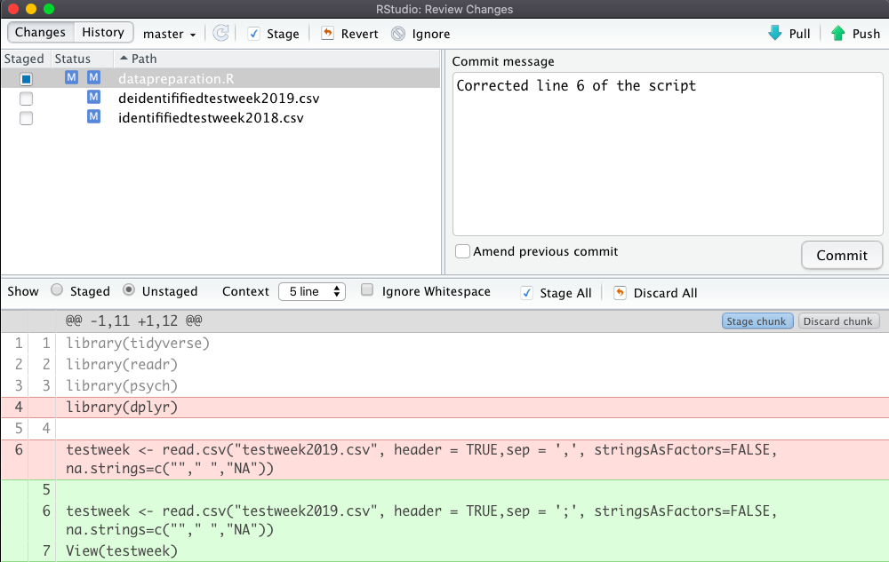
GitHub: What are we talking about?
How to do a commit:
1) You select which files will be included in the next commit
2) You provide a comment of the changes you want to commit
3) A changeset display which shows files changed, added or removed
Notes:
Explain with a Metaphor: doing a commit is like when you save the game. You take a snapshot of the file. You will not lose it anymore

Slide 20
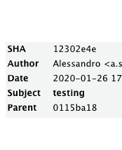

GitHub: What are we talking about?
What are the elements of a commit?
1
SHA (secure has algorithm)
2
Author
3
Date
4
Subject
5
Parent
Which is the previous commit The initial commit doesn’t have a parent)

Slide 21
GitHub: What are we talking about?
What should you put in a commit:
Changes related to a single issue you have solved. For the following issue it is good practice to do a separate commit
The commit message:
Enough details which can explain what was done.
It should provide a high-level summary which focuses on why you have changed the script

Slide 22

GitHub: What are we talking about?
Clear messages will help not only your collaborators but also future yourself

Slide 23
GitHub: What are we talking about?
Pushing to GitHub
To push the code to GitHub:
Save a file and commit
Push the changes to GitHub by clicking Push
Refresh your GitHub page and see how it is changed
Usually you want to push after that you have done some commits.

Slide 24
GitHub: What are we talking about?
How to do a push:
You push your
changes to your GitHub repository

Slide 25
GitHub: What are we talking about?
How to do a pull:
If one of your collaborator want to see the changes, he has to pull them from the GitHub repository

Slide 26
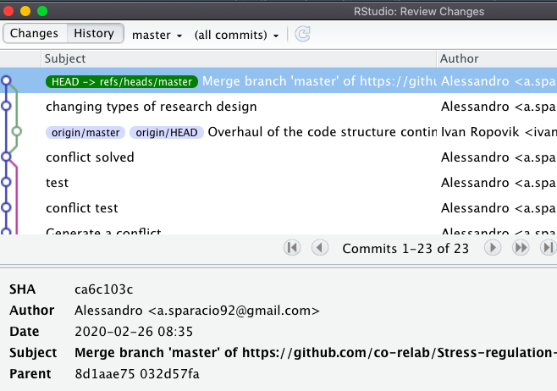
GitHub: What are we talking about?
Git allows you to see a history of the changes made to your script

Slide 27
GitHub: What are we talking about?
Clone, push & pull in a nutshell
GitHub repo
clone
Olivier

Slide 28
GitHub: What are we talking about?
Clone, push & pull in a nutshell
GitHub repo
Olivier
clone
Patrick

Slide 29
GitHub: What are we talking about?
Clone, push & pull in a nutshell
GitHub repo
push
Olivier
Patrick

Slide 30
GitHub: What are we talking about?
Clone, push & pull in a nutshell
GitHub repo
Olivier
pull
Patrick

Slide 31

GitHub: What are we talking about?
A use case: Working with a collaborator
Script of Testweek 2019/2020

Slide 32
GitHub: What are we talking about?
Problem: Debug the script of the testweek
Correct the script
Spot the mistakes in the script

Slide 33


GitHub: What are we talking about?
Without GitHub
1
2
3
4
5
Patrick has to download the uncorrected script and spot the mistakes
Patrick has to signal the mistakes in the script with comments and send it to Olivier
Olivier has to download the uncorrected script, make changes and put comments in order to make Patrick aware of the changes
Olivier has to send via email a new version of the script to Patrick
Patrick can see the changes looking at the comments in the corrected script of Olivier

Slide 34
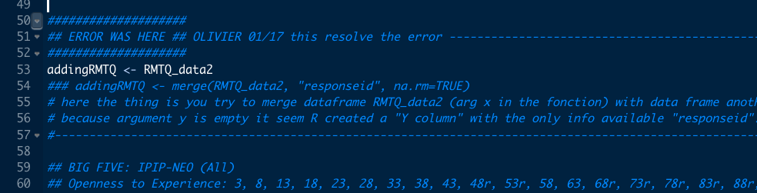
GitHub: What are we talking about?

Slide 35
GitHub: What are we talking about?
With GitHub
1
2
3
4
5
1) Patrick has to download the uncorrected script (from GitHub) and spot the mistakes
Patrick has to signal the mistakes in the script with comments (but GitHub will make it easy to see them)
Olivier has to download the uncorrected script (from GitHub), he has to make changes and finally he has to push the corrected script to GitHub (no comments are needed)
Patrick has to pull the new corrected script from GitHub (no mail is needed) to see the changes
Bonus: They can work at the script at the same time!

Slide 36
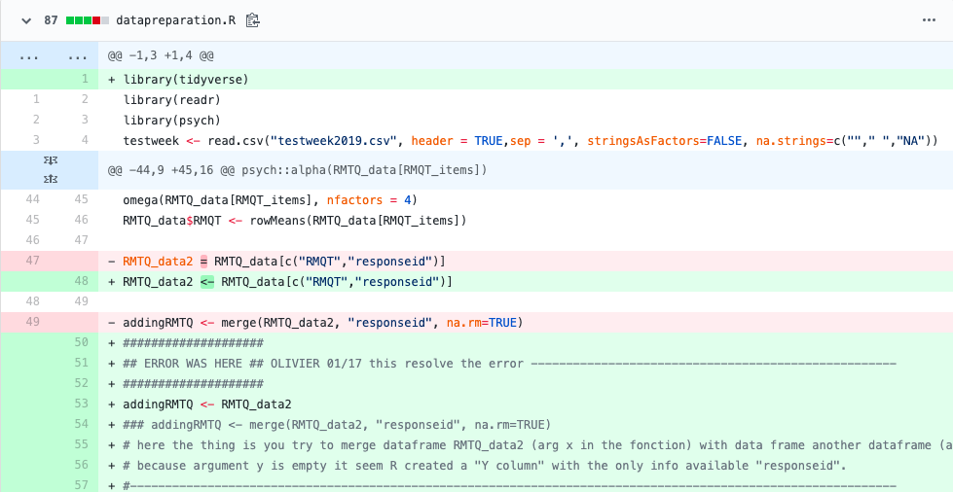
GitHub: What are we talking about?

Slide 37
GitHub: What are we talking about?
Working with collaborators:
Push to send your changes to GitHub
Your collaborators will pull the changes from GitHub to their local repository
N.B. You can push if you have retrieved the most updated version of the file with a pull

Slide 38
GitHub: What are we talking about?
Working at the SAME TIME with collaborators:
When you pull, Git first fetches the modifications that have been done and then merges them with changes that you have done.
If they refers to different part of the code, there will not be any problems
If they are related to the same line of code, you have to resolve the merge conflict yourself

Slide 39
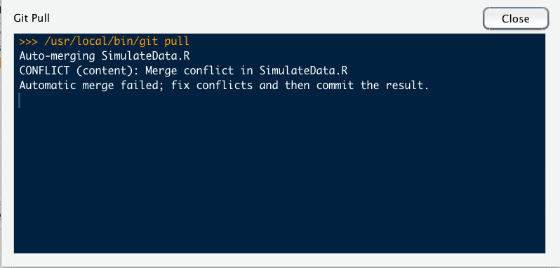
GitHub: What are we talking about?
How to merge a conflict:

Slide 40
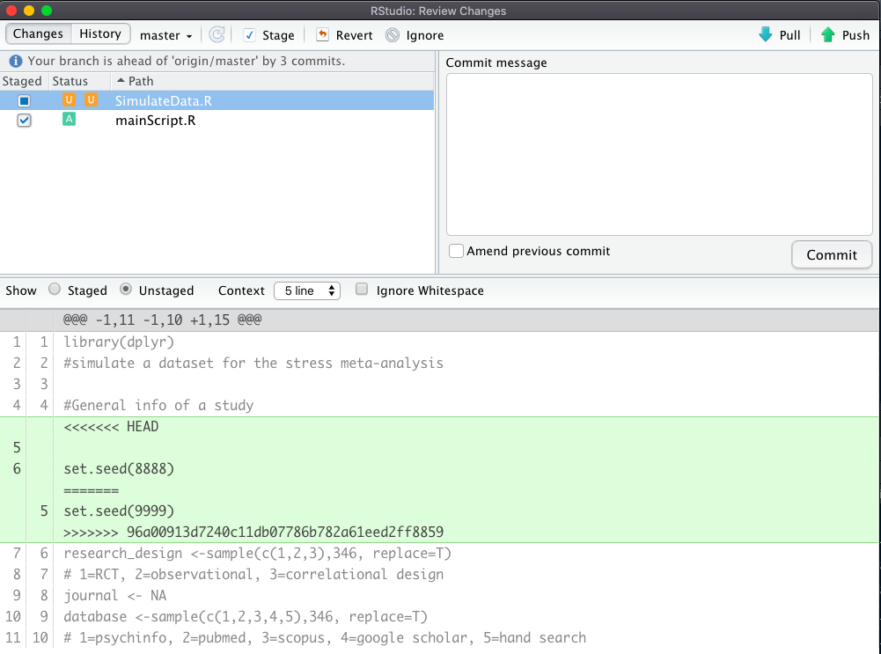
GitHub: What are we talking about?
How to merge a conflict:
The conflict is displayed in the same commit interface

Slide 41
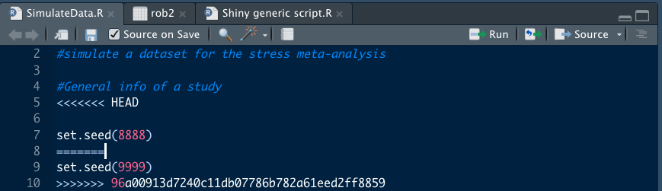
GitHub: What are we talking about?
How to merge a conflict:
The conflict can be solved by modifying directly the script (by removing one line of code or the other)

Slide 42
GitHub: What are we talking about?
Branches:
When you want to make big changes to your script without having to disturb the main stream of development.
The default branch is called master. If you synchronise the code to GitHub you will have a branch called origin/master.
Branches are useful when you want to break away from the main stream of development

Slide 43
GitHub: What are we talking about?
Branches:
When you have done working on a branch, you can either merge it back into the master or you can delete it

Slide 44
GitHub: What are we talking about?
Conclusions
Advantages for using GitHub
No need to save more version of the same file
Easy to spot mistakes
Allow to work with others at the same time
Need to learn a few basic actions only (e.g. commit, push & pull)
Future you, will thank you

Slide 45
GitHub: What are we talking about?
Conclusions
Disadvantages for using GitHub
User interface is not really user friendly
Your collaborators should have GitHub too, if you want to work with them using GitHub

Slide 46




Co-Regulation (CORE) Lab
La pêche!
Thank you for listening
https://corelab.io

Slide 47
Co-Regulation (CORE) Lab
Thank you for listening
https://corelab.io

